Slide 1
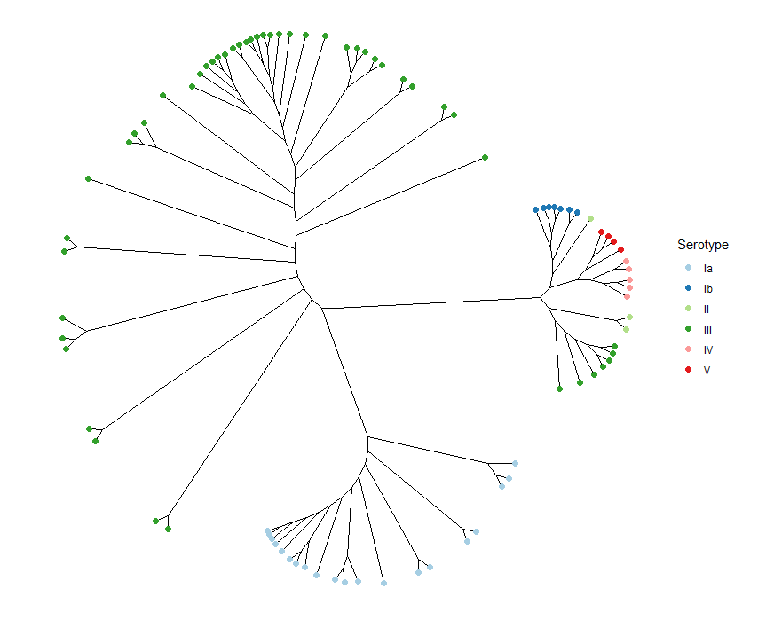
CC17
CC12
CC1
CC19
CC23

